Slide 1

INDIA'S AGRICULTURE CROP PRODUCTION ANALYSIS (1997-2021)
TEAM LEADER:- LAALSHREE. S
TEAM MEMBERS:- PRIYA. S
PUSHPA. M
RIYANA. F
SANDHIYA. S

Slide 2
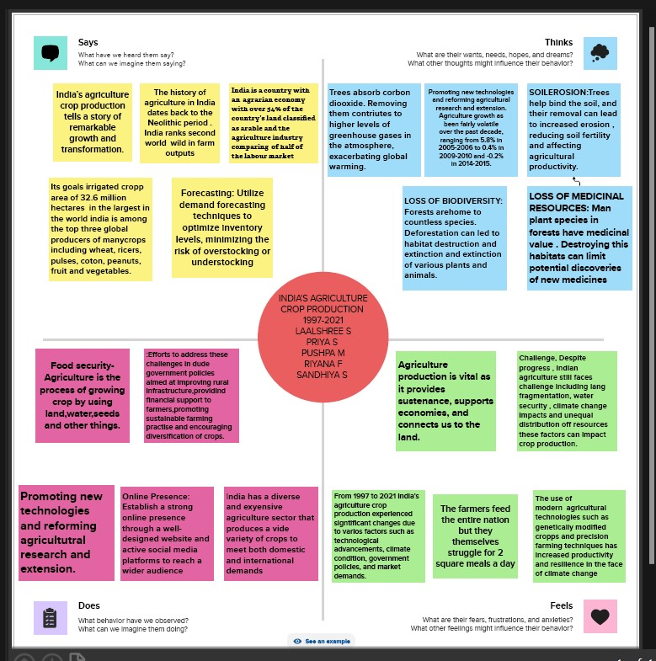
EMPATHY MAPPING

Slide 3
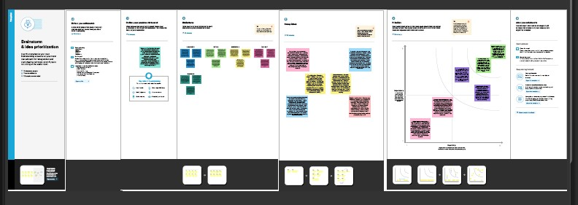
BRAINSTROMING IDEAS

Slide 4

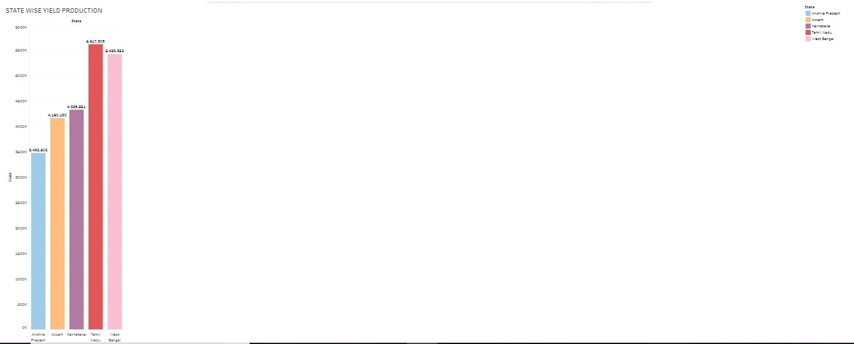

Slide 5
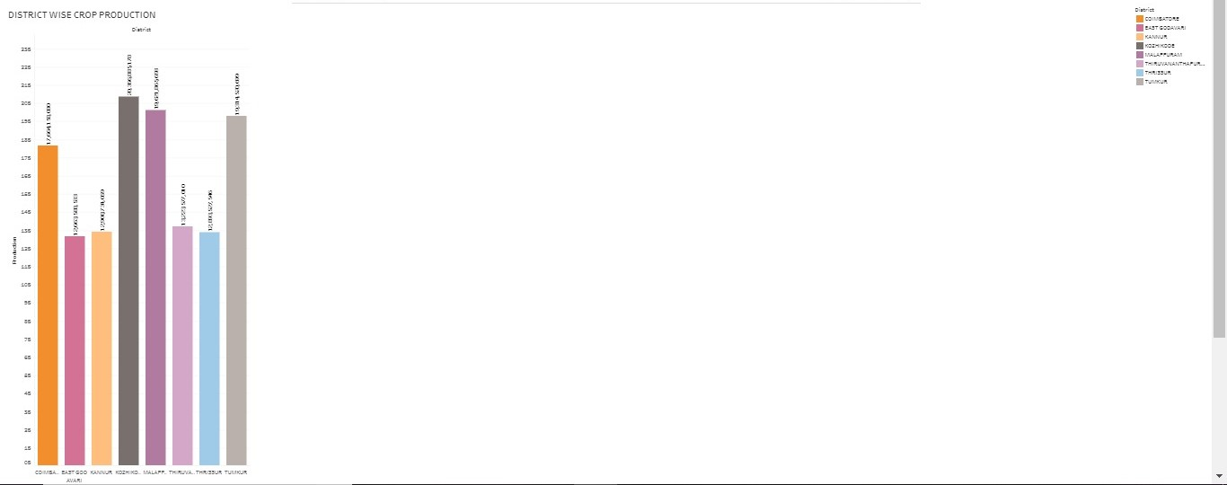

Slide 6
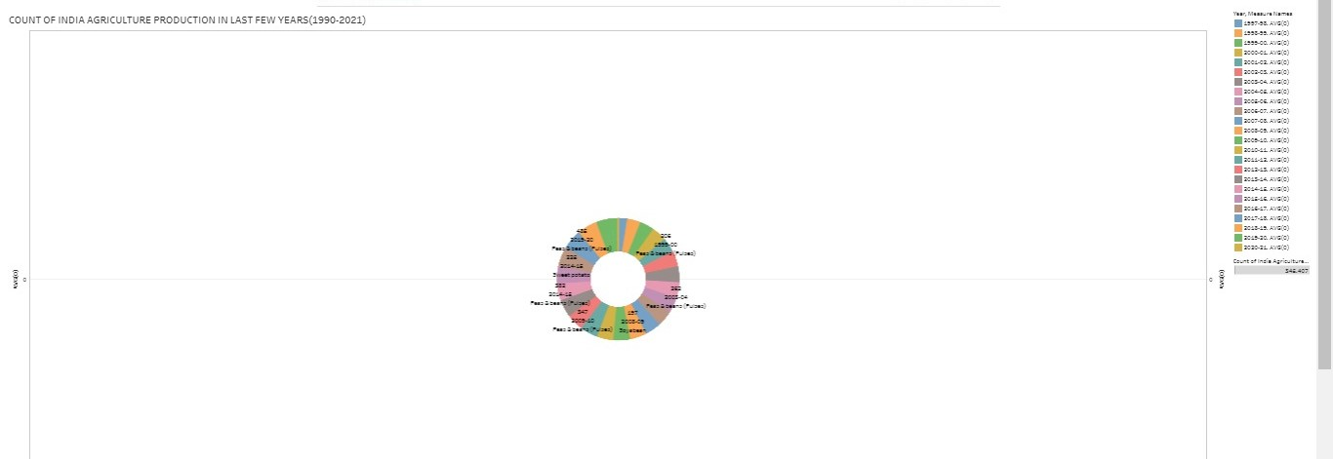

Slide 7
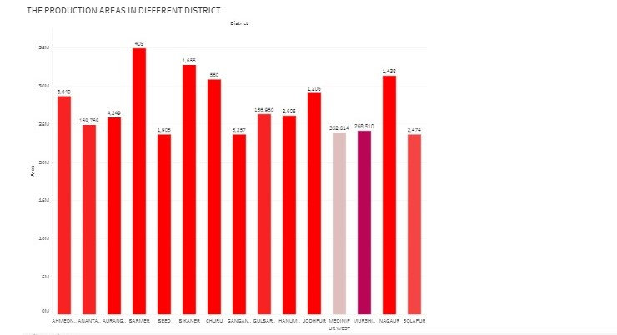

Slide 8

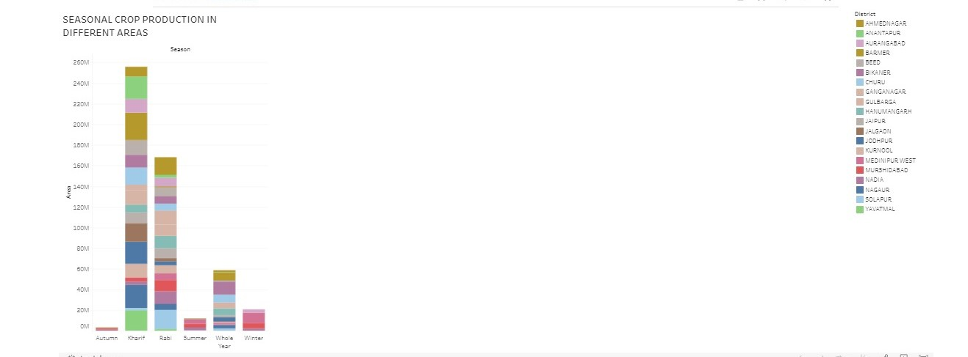

Slide 9
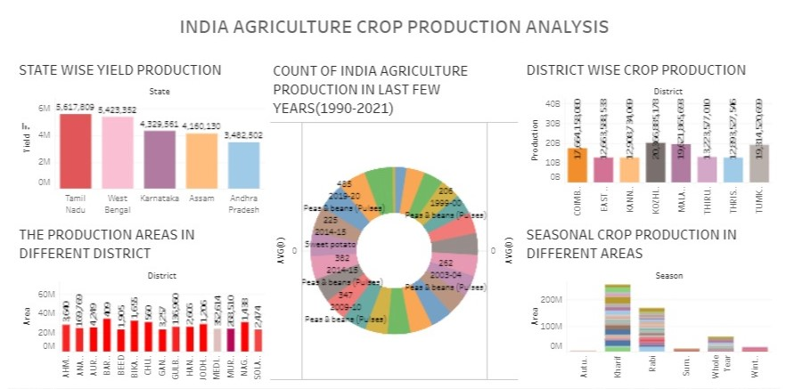

Slide 10
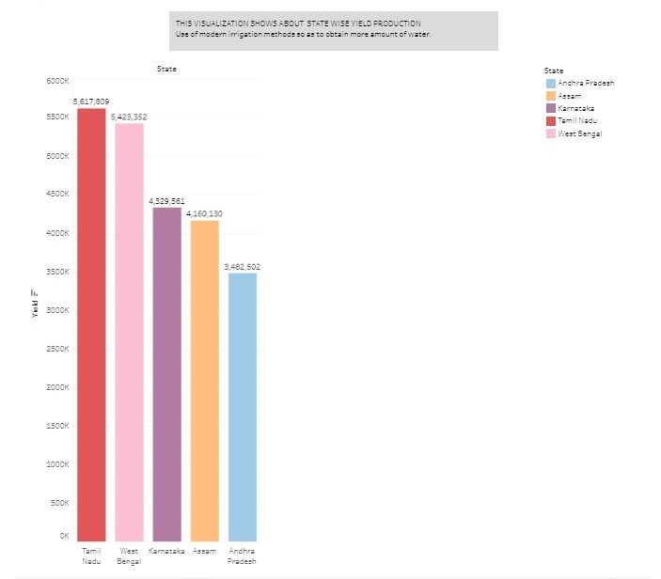

Slide 11

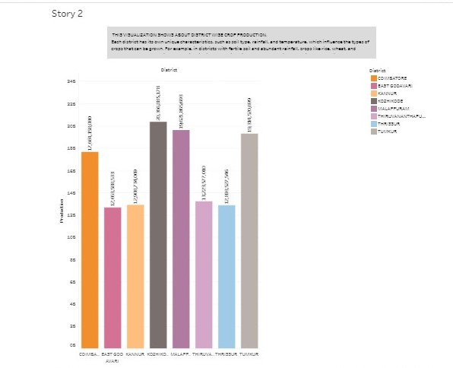

Slide 12
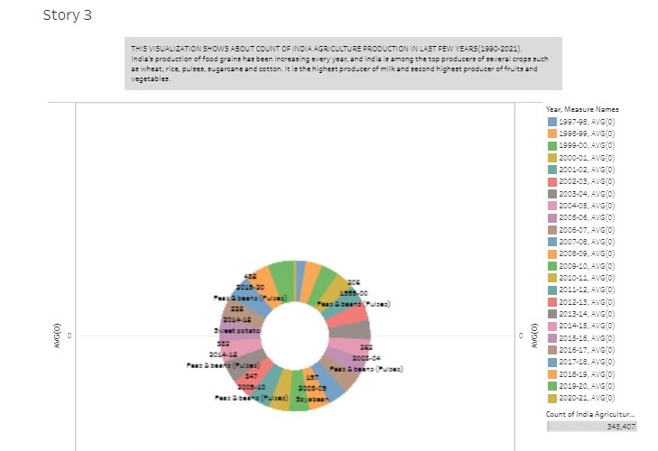

Slide 13
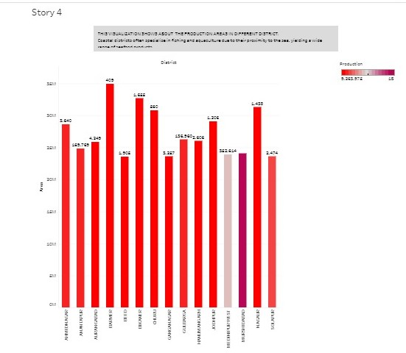

Slide 14
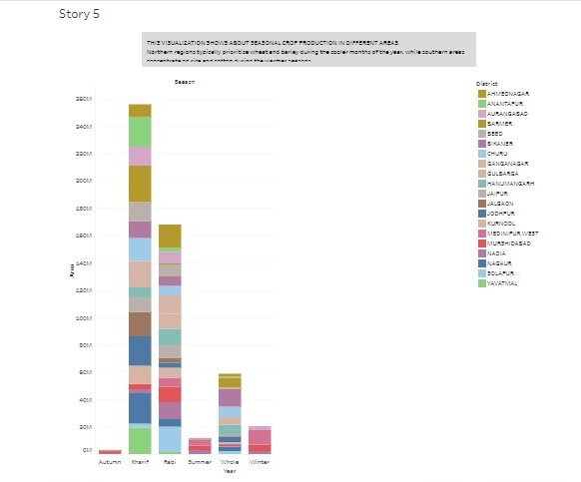

Slide 15
THANK YOU

